Slide 1

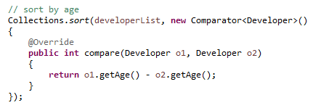
Java 8 Lambda : Comparator example
Or

